Slide 1
Multiple early factors anticipate post-acute COVID-19 sequelae
Patricia Colom Díaz
Chaewon Heo

Slide 2
Background
31%-69% of covid-19 patients suffer from post-acute sequelae of covid-19 (PASC)
PASC may include memory loss, gastrointestinal distress, fatigue, anosmia, shortness of breath, etc
PASC is suspected to be involved with autoimmune factors and unresolved viral fragments

Slide 3
Research question:
What immunological factors determine the severity of post-acute sequelae of covid-19 (PASC)?
Notes:
The authors carried out a longitudinal multi omics study from initial diagnosis to early stage recovery from acute disease to identify and quantify immunological factors

Slide 4
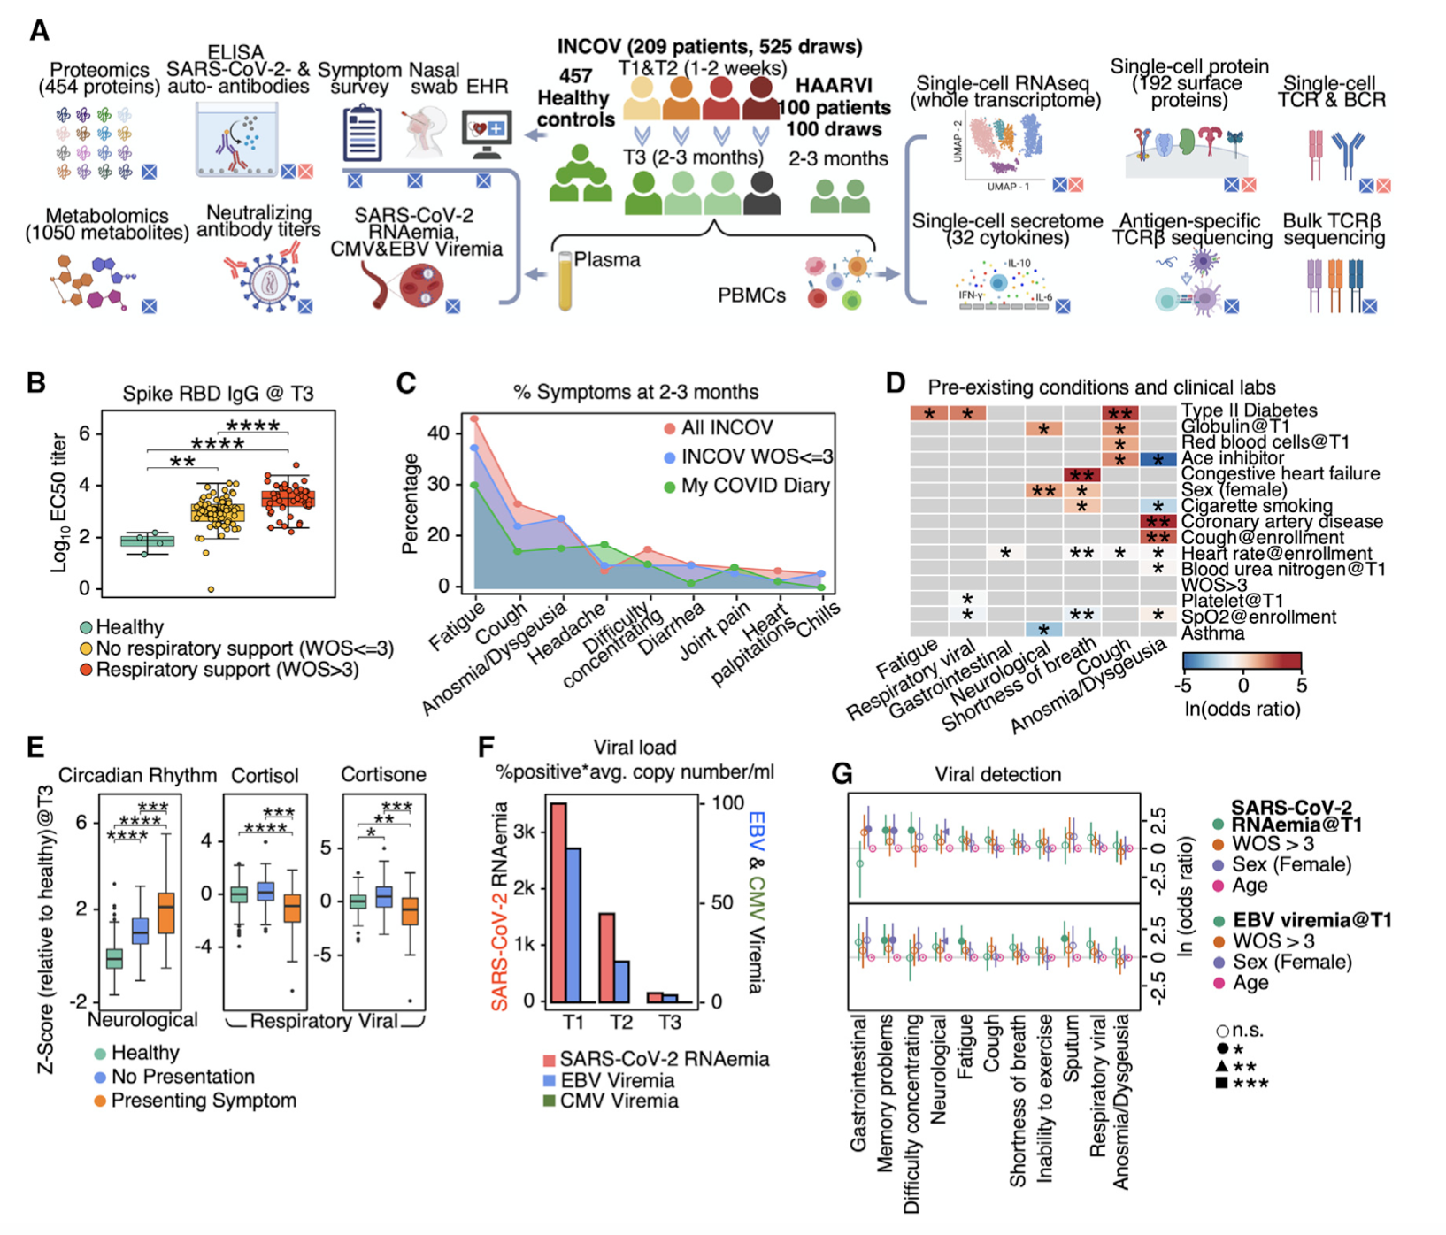
Figure 1. Overview of longitudinal analysis of COVID-19 patients and their association with PASC
Study Design:
Notes:
Fig 1a - shows the overview of study design for two main patient cohorts: INCOV and HAARVI
Here,
INCOV (blue) patients: 209 patients that represent the spectrum of acute infection severity
HAARVI (pink): 100 patients subsetted from INCOV cohort who were hospitalized with respiratory-viral infections)
457 healthy controls
Patients were studied at three different timepoints:
T1: at clinical diagnosis stage
T2: acute disease stage
T3: 2-3 months post onset of initial symptoms
For each patient and time point:
Blood draws were analyzed for:
autoantibodies (autoAbs)
Covid specific antibodies
Global plasma proteomic and metabolomic profiles
Single-cell multi-omic characterizations of peripheral blood mononuclear cells (PBMCs)
Together with electronic health records, self reported symptoms and nasal swabs,

Slide 5
Figure 1. (cont)
Notes:
1B:
Colors:
Green: healthy controls
Yellow: incov
Red: haarvi
1B shows the antibody levels against covid via spike protein receptor binding domain (rbd) levels
The diagram shows that in T3, most participants exhibited antibodies against the covid spike protein receptor binding domain, and that the antibody titers correlates with acute disease severity.
1C:
Diagram that shows the percentage of symptoms that appeared at 2-3 months - it can be shown that all cohorts, no matter how severe the covid was, exhibited similar trend in symptoms where fatigueness was the most common among all patients
This implies that factors beyond acute-stage disease severity could be associated with PASC
1D:
Examining PASC in the context of electronic health record data, the heatmap shows significant correlation for type 2 diabetes and chronic obstructive pulmonary disease
1E:
Team studied plasma proteomic and metabolic biomarkers at convalescence associated with pasc such as circadian rhythm pathway, cortisol level, cortisone levels at T3.
Low cortisol is the hallmark of adrenal insufficiency that can cause similar symptoms as PASC and has been reported in acute covid-19 patients but not at convalescence.
One hypothesis for low cortisol production is that it’s due to steroid treatments from feedback inhibition
Patients reporting neurological symptoms exhibited elevated proteins associated with negative regulation of the circadian sleep/wake cycle. These biomarkers suggest distinct origins of PASC subsets
Circadian rhythm pathway/cortisol level/cortisone levels
1F:
Epstein-barr virus (EBV) has been indirectly inferred to correlate with PASC through antibody titer measurements according to 2021 paper from Gold et al.
The team probed for the reactivation of latent viruses by measuring plasma viremia of EBV and cytomegalovirus (CMV) which is a second common latent virus as well as probing for circulating mRNA fragments of covid (RNAemia)
From Figure 1F it can be seen that EBV viremia was detected 14% at T1 patients and positive covid RNAemia detected for 25% of patients. For both viral assays, signals dropped 2-3fold between t1 and t2 and were barely detected at t3 + CMV vireia was not detected
1G:
Team analyzed whether EBV viremia, RNAemia, or covid viral load from nasal swabs were significantly associated with PASC at T3. It was found that memory PASC was significantly associated with T1 measures of both EBV viremia and RNAemia.
In particular,
Memory PASC was significantly associated with T1 measures of both EBV viremia and covid RNAemia
Fatigue and sputum PASC were specific to EBV viremia
Summary:
Reactivation of latent EBV and SARS-cov2 RNAemia at T1 are factors that anticipate PASc at T3

Slide 6
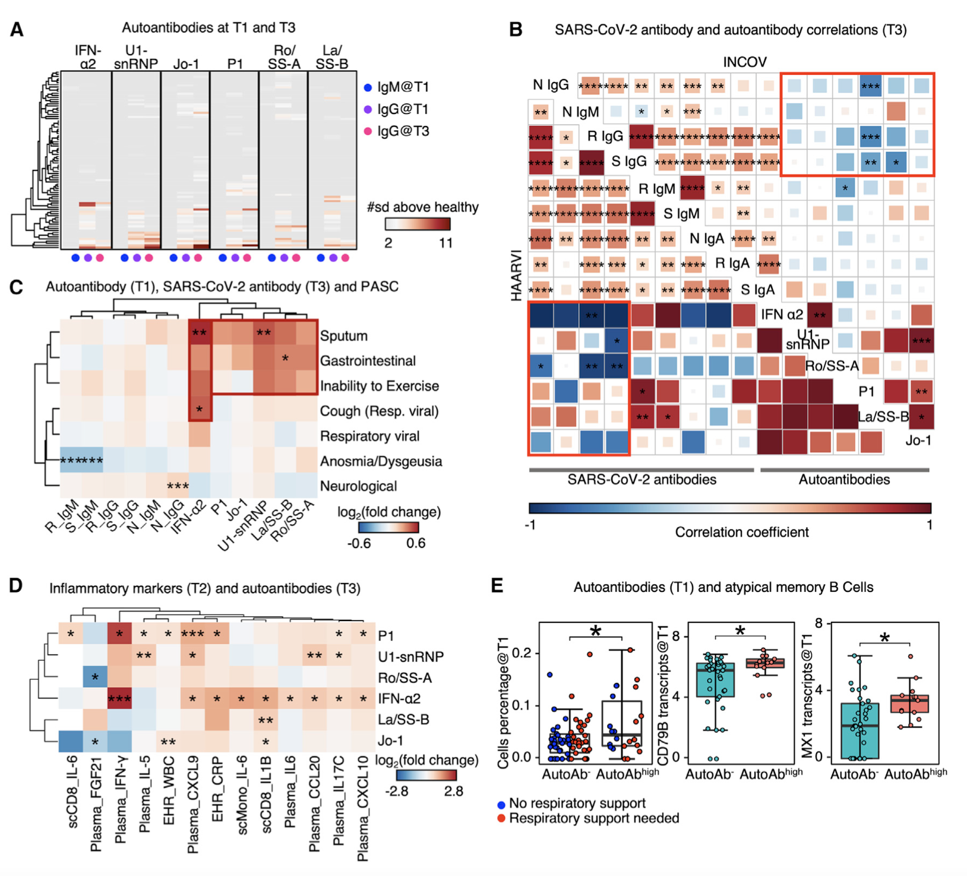
Figure 2. Autoantibodies anti correlated with anti-SARS-CoV-2 antibodies and are associated with distinct patterns of PASC
Notes:
Autoantibodies have been reported to be associated with immune dysfunction and covid19 mortality (bastard et al 2021, wang et al 2021)
2a:
Heatmap showing the IgM at T1, IgG at T1, and IgG at T3 for each autoantibody annotated at the top. Each row represents a patient. Only patients with measured autoantibody levels above 2 standard deviations (s) of healthy individuals are shown.
Team observed that patients with autoAbs at T3 already exhibited mature autoAbs as early as at diagnosis, indicating that the autoAbs may prodate covid-19, as reported elsewhere (bastard et al 2021)
EHR data analysis confirmed that only 6% of autoAb-positive patients had documented autoimmune conditions before covid-19, suggesting that the autoAbs may reflect subclinical conditions.
2b:
Two aligned correlation matrices assembled from INCOV (upper right) and HAARVI cohorts (lower left). Each square represents the correlation coefficient between an antibody pair specified by the diagonal annotations. p values of these correlations are displayed in asterisks if <0.05. *p value < 0.05, **p value < 0.01, ***p value < 0.001, and ****p value < 0.0001. N, nucleocapsid protein; S, spike protein; R, RBD domain of spike; Ig, immunoglobin. Pink rectangles highlight the overall anti-correlation trends between auto-antibodies and anti-SARS-CoV-2 IgGs.
Cross-correlations between autoAbs and anti-covid Abs at T3 were found. Anti covid IgG titers positively correlated withe ath other as did the autoAbs. All significant correlations between IgG and AutoAbs are anticorrelations
shapes
2c:
Hierarchical clustered heatmap showing log2-fold change of T3 SARS-CoV-2 antibody or T1 autoantibody levels in patients with a specific PASC (rows) compared with those without. p values calculated from the Mann-Whitney U test are displayed if <0.05. Only single PASCs that showed statistical significance or the four PASC categories were shown. *p value < 0.05, **p value < 0.01, and ***p value < 0.001.
These observations suggest that T1 autoAb levels may be anticipating biomarkers of certain PASC

Slide 7
Figure 2. (cont)
Notes:
2d:
Hierarchical clustered heatmap showing log2-fold change of EHR clinical labs, plasma analytes, or transcript levels in immune cells (annotated within column names), in patients with auto-antibodies (>2s + healthy) to those without (%2s + healthy). p values calculated from the Mann-Whitney U test are displayed in asterisks if <0.05. *p value < 0.05, **p value < 0.01, and ***p value < 0.001.
2e:
Boxplots showing the cell percentage (left), CD79B transcript levels (middle), and MX1 transcript levels (right) of atypical memory B cells in patients without any auto-antibodies (autoAb, %2s + healthy) and those had any autoantibody levels R4s + healthy (autoAbhigh). p values calculated from the Mann-Whitney U test are displayed in asterisks if <0.05. *p value < 0.05. See also Figure S2 and Tables S2 and S5.

Slide 8
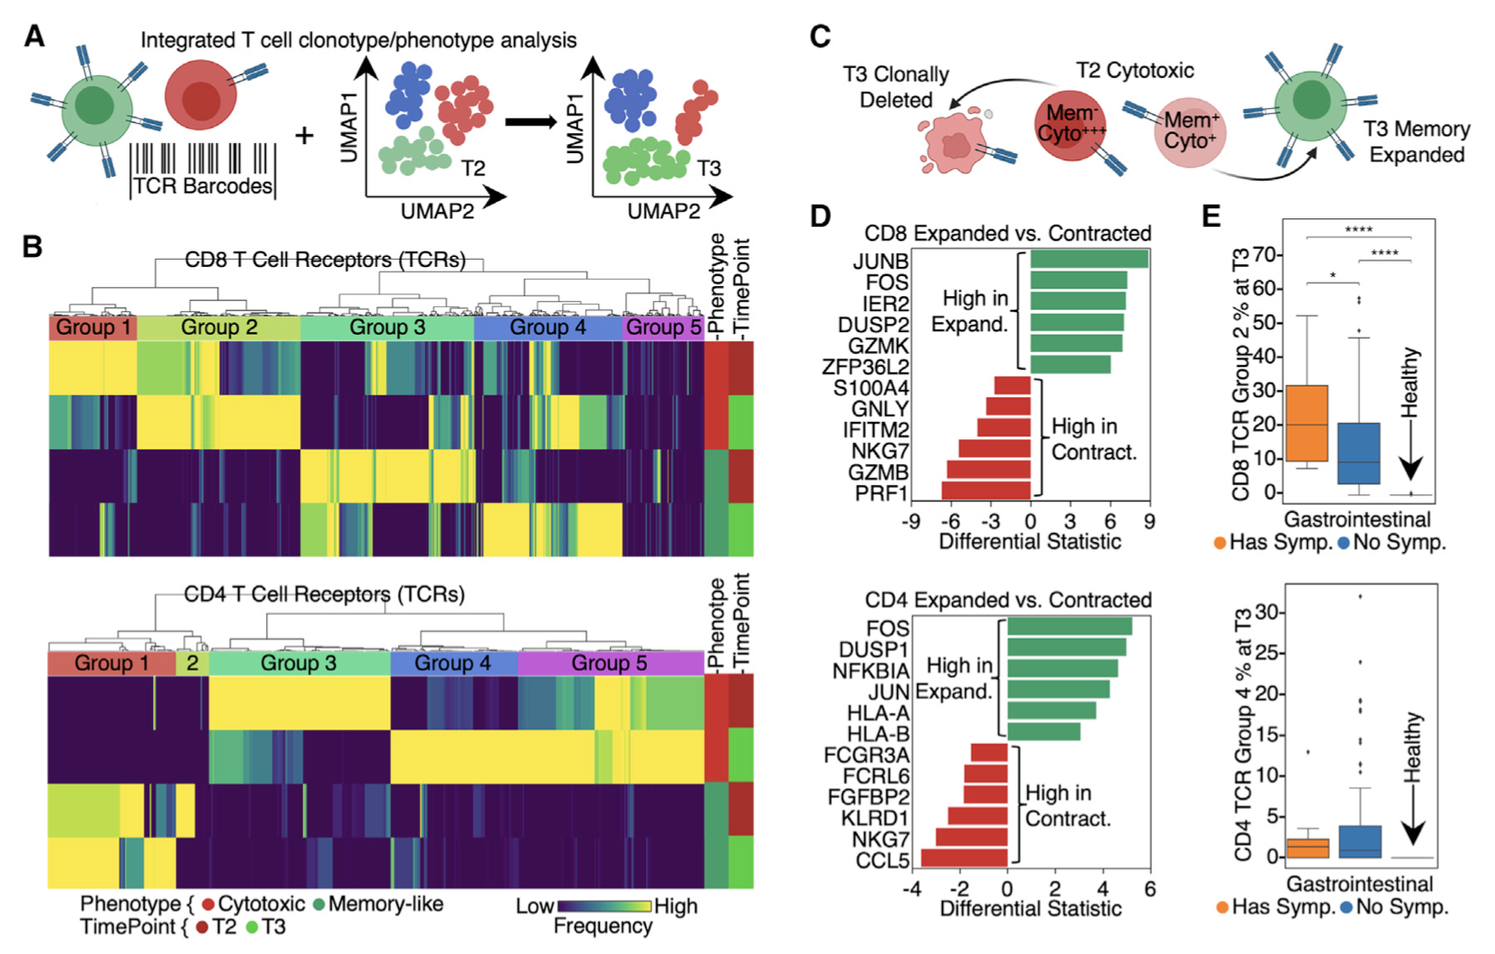
Figure 3. Lineage tracing of T cell clonotypes along the transcriptomic landscape resolved PASC association with global clonal and transcriptomic dynamics
Notes:
3a
Illustration of using TCRs as t-cell lineage barcodes to trace how different clonotypes evolve along transcriptomic landscape from acute disease to convalescence
3b
hierarchical clustering of CD8+ and CD4+ t-cell TCRs based on TCR sharing patterns across select phenotypes and time points

Slide 9
Figure 3. (cont)
Notes:
3c:
Illustration of mining differential transcriptomic features for cd8 and cd4 cells that are of a cytotic T-emra phenotype at T2 but expanded into a memory phenotype at T3, or contract at T3
3d:
Top differentially expressed genes at T2 between cytotoxic T-emra cells that either expand into a memory phenotype, or contract by T3. CD8(top) and CD4(bottom)
The implication is that for cytotoxic T cell phenotypes, dif- ferences in early transcriptional programs may lead to divergent cell fates. These observed behaviors of T cell clonal contraction and memory-formation likely reflect normal recovery from COVID-19, similar to those in other viral infection settings (Kaech et al., 2002).
3e:
Frequencies of newly emerging cytotoxic clonotypes for patients at T3 with (orange) and without (blue) gastrointestinal symptoms
These analyses suggest that GI PASC is associated with unique T cell clonal and transcriptome dynamics, prompting us to explore the antigen specificity of these T cell populations.

Slide 10
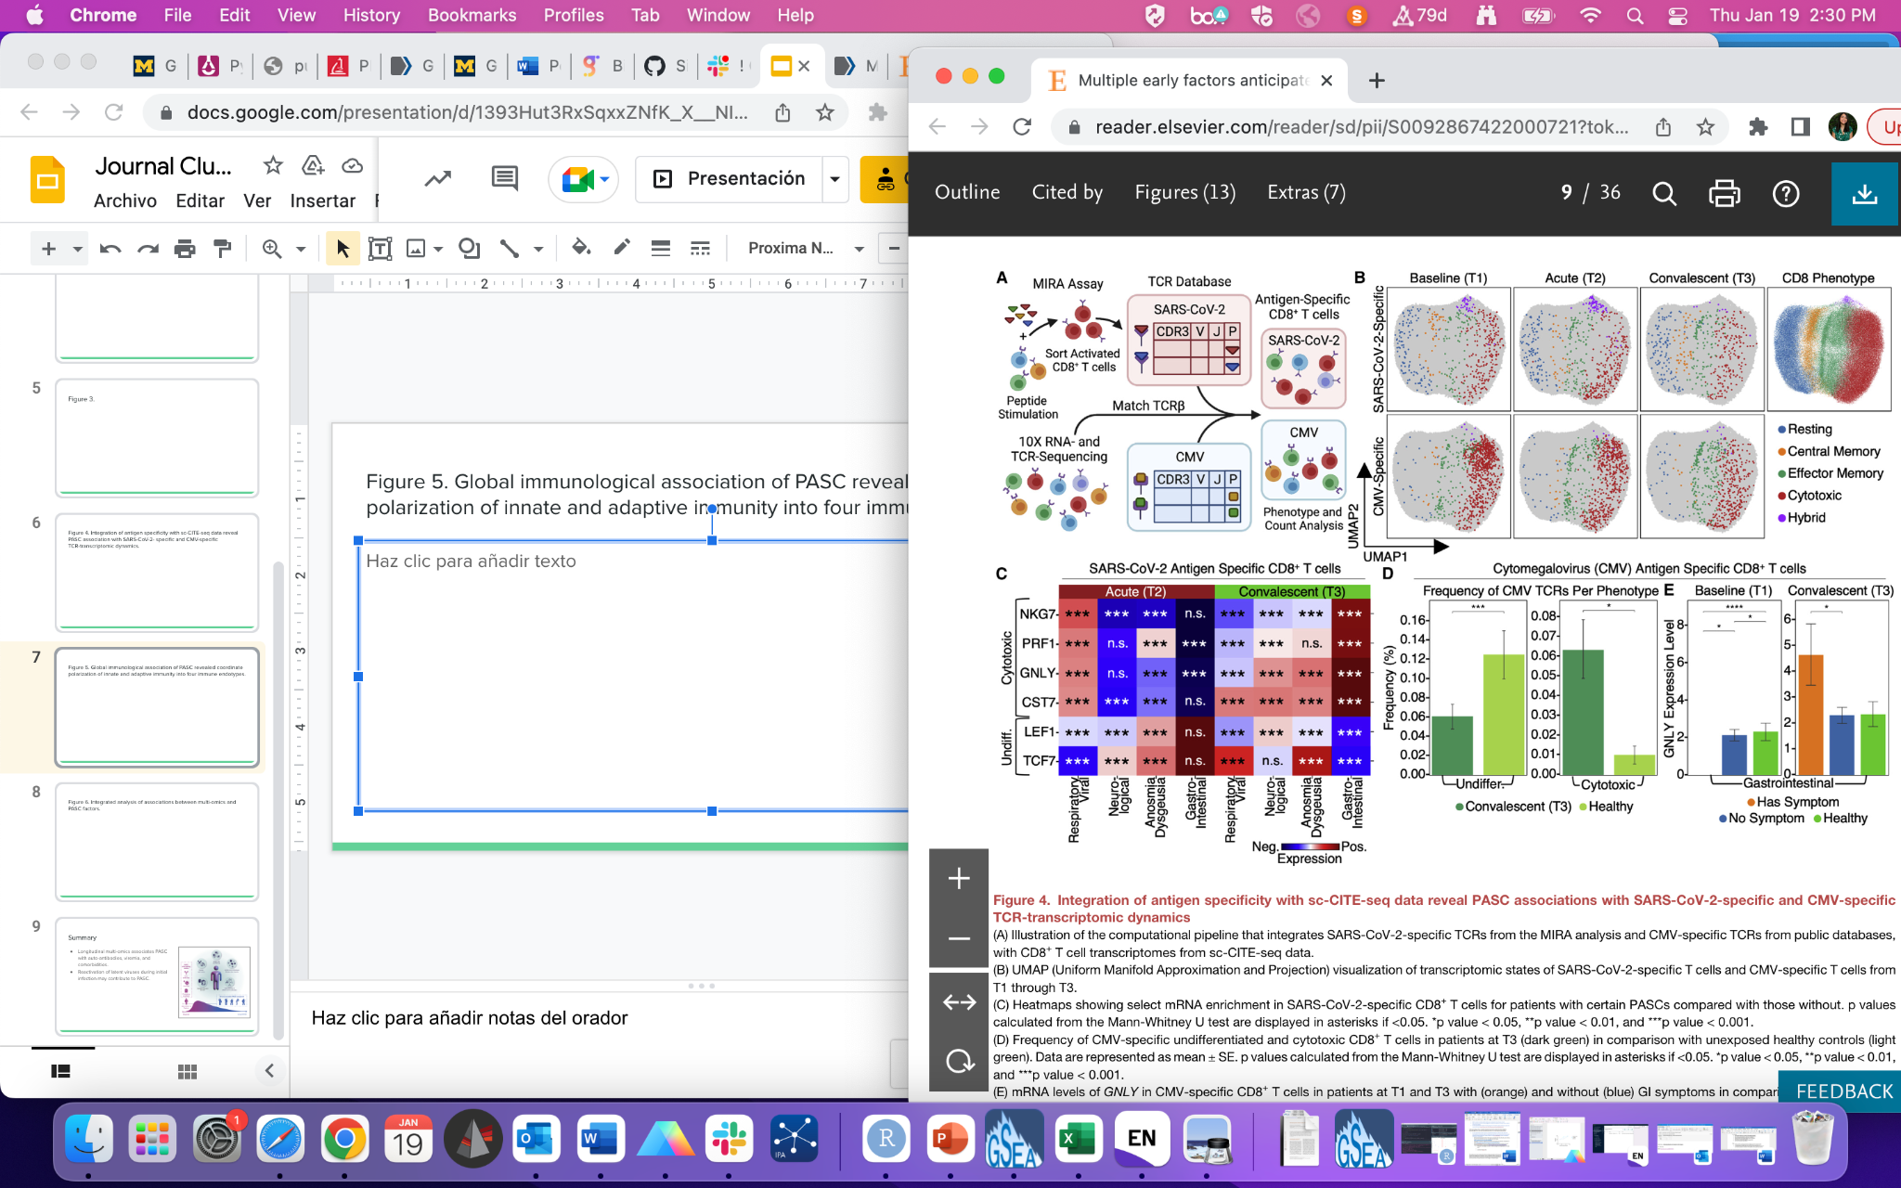
Figure 4. Integration of antigen specificity with sc-CITE-seq data reveal PASC association with SARS-CoV-2- specific and CMV-specific TCR-transcriptomic dynamics.
Notes:
Next the authors set out to investigate transcriptional dynamics of SARS-CoV-2 specific T cells, by performing a functional assay for the multiplex identification of TCR antigen specificities (MIRA) on COVID patients where they identified over 600 epitopes.
Figure B shows the transcriptome of SARS-Cov specific to CD8 T cells.

Slide 11
Figure 4. Integration of antigen specificity with sc-CITE-seq data reveal PASC association with SARS-CoV-2- specific and CMV-specific TCR-transcriptomic dynamics.

Slide 12
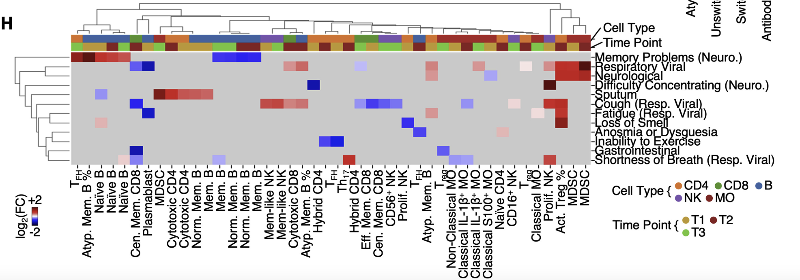
Unresolved dysregulated immune phenotypes associate with different PASC
Memory-like NK, Treg

Slide 13
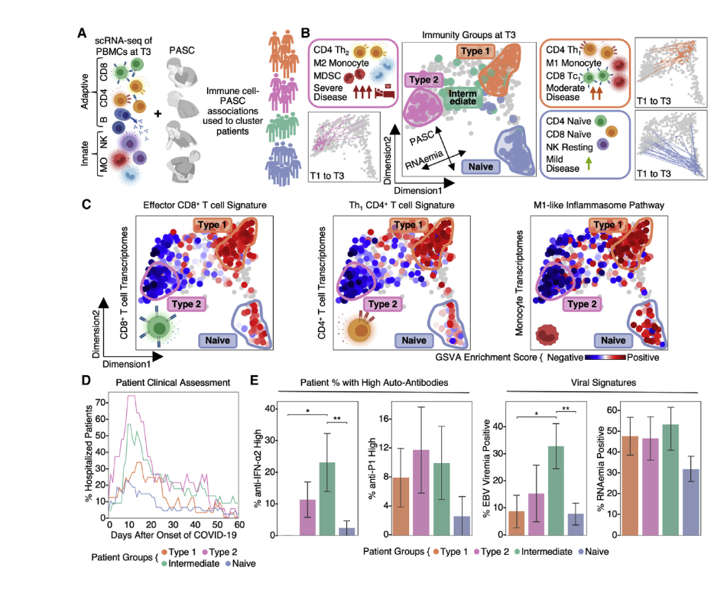
Figure 5. Global immunological association of PASC revealed coordinate polarization of innate and adaptive immunity into four immune endotypes.

Slide 14
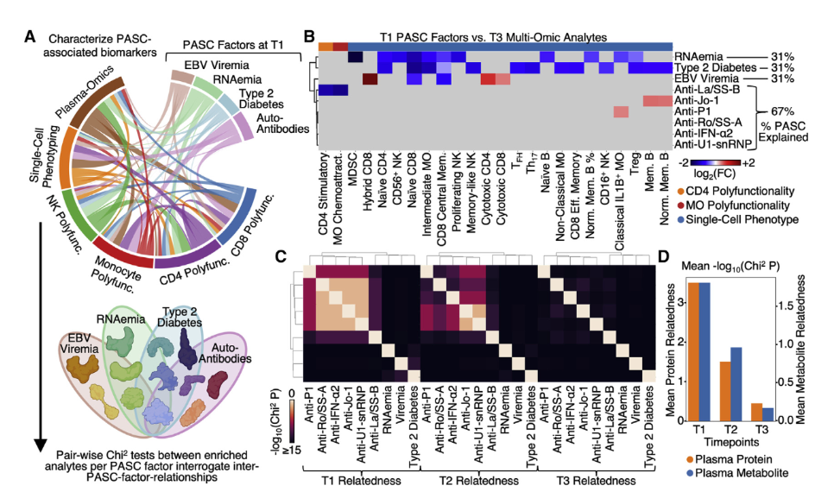
Figure 6. Integrated analysis of associations between multi-omics and PASC factors.

Slide 15
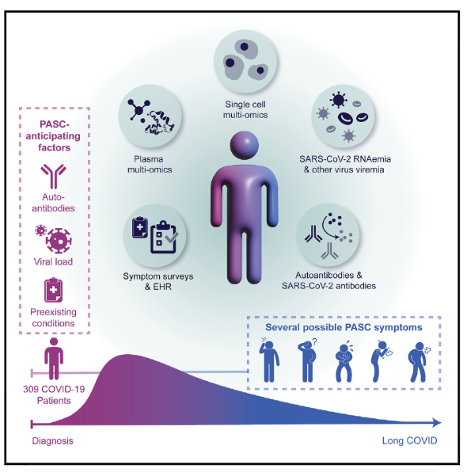
Summary
Longitudinal multi-omics associates PASC with auto-antibodies, viremia, and comorbidities.
Reactivation of latent viruses during initial infection may contribute to PASC.
Subclinical auto-antibodies negatively correlate with anti-SARS-CoV-2 antibodies.
Gastrointestinal PASC uniquely present with post-acute expansion of cytotoxic T cells.

